Slide 1

STUDENT PROJECT
THE RUSSIAN SPIES
Voysyat Egorova Zlobin Kryuchkova

Slide 2





CONTENTS
DATA BASE
FORMATTING
Scheme DB Selecting
ER-chart
Template
Format
CSV
SCRIPTS
VISUALIZATION
Importing
Analysis
Parsing
Outlier
Graph
View

Slide 3

FORMULATION OF THE PROBLEM
Starting data
Documents from various sources, such as booking sites, frequent flyer forums, ticket agencies, etc., on flights of several suspicious Russian citizens...
Goal
To develop algorithmic and software for the analysis of specific data in order to identify patterns and outliers in these data for further use as search tools..
Result
Automated tools for searching for anomalies and outliers in some structured data set obtained from a database, the structure and data of which are obtained directly from the available input data...

Slide 4
WORK PLAN
1
Analysis of the source data
2
Discussion of methods for anomaly detection
3
Creating an ER-chart
4
Formatting source data
5
Creating a database schema
6
Import data into the database
7
Creating a plan for the implementation of ideas
8
Implementing ideas: creating scripts
9
Presentation of results in a visual form

Slide 5



ER-CHART
Passenger
Fare
Airports
Loyalty program
Ticket
Trip
Flight
Meal
Aggregator
Aircrafts

Slide 6
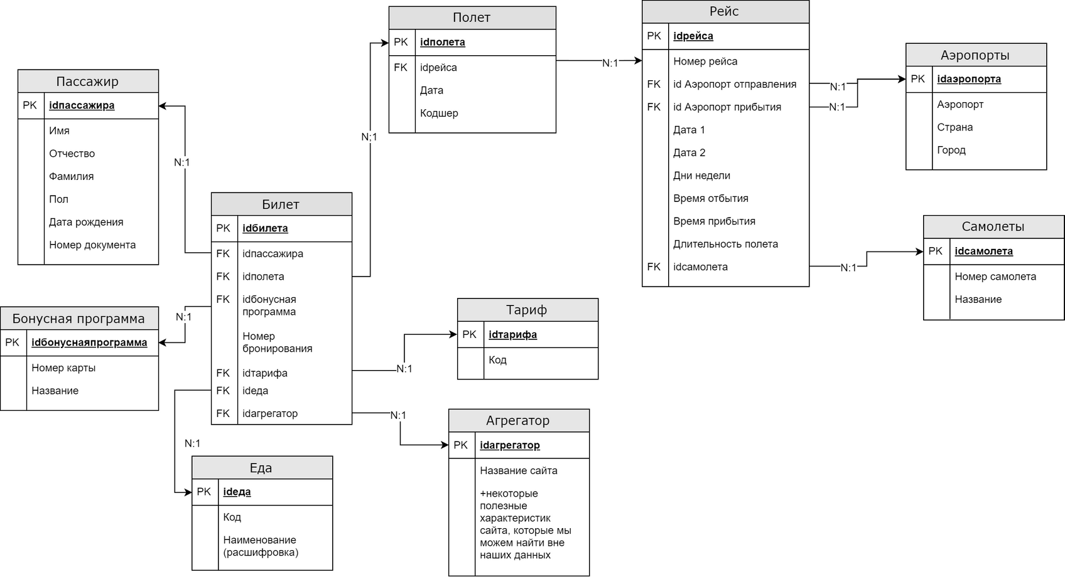
ER-CHART

Slide 7
FORMATTING
JSON
YAML
XLSX
|@*%^$\| | ; _ ; _ ; _ ;|
CSV
PDF
TAB

